Slide 1
Unit 5
Planning – planning problem – Simple planning agent – Blocks world problem – Mean Ends analysis Learning - Machine learning - Learning concepts, methods and models Introduction to expert system – architecture of expert systems.

Slide 2
Planning
Planning refers to the process of deciding a sequence of actions that a system must take to achieve a specific goal.
Planning can be classified as:
1. Classical Planning
Fully observable, deterministic, finite, static and discrete.
2. Non classical Planning
Partially observable, stochastic with different algorithms and agent designs.

Slide 3
Importance of Planning in AI
Efficiency and Optimization:
  Planning allows AI systems to choose the most efficient route to achieve a goal, minimizing resource usage and time.
Adaptability:
  In real-world applications, AI systems often face uncertain environments. By incorporating planning, AI can adjust its course of action in response to new information or unforeseen obstacles.
Autonomy:
  Planning is a key factor that enables AI systems to act autonomously, the ability to perform tasks without constant human intervention.
Decision-Making:
  AI systems that utilize planning can make informed decisions by considering different possible outcomes. This makes planning critical in applications like medical diagnosis systems, financial forecasting, or game AI.

Slide 4
Planning Problem
The planning problem is actually the question how to go to next state or the goal state from the current state. It involves two things 'how' and 'when'.
The planning problem is defined with:
Domain model
The domain model defines the actions along with the objects.
It is necessary to specify the operators too that actually describe the action.
Along with this, information about actions and state constraints while acting should also be given
2. Initial state
The initial state is the state where any action is yet to take place (the stage when the exam schedule is put up!).
3. Goal state (next state)
The final state or the goal state is the state which the plan is intended to achieve.

Slide 5
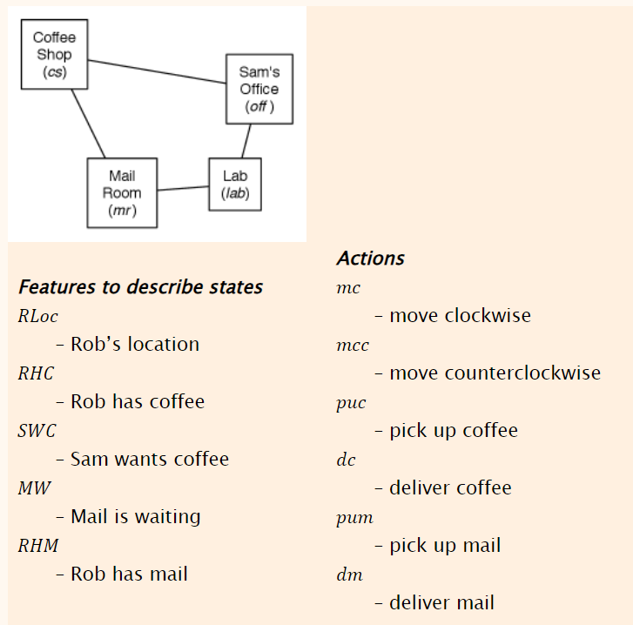
Planning Representation
Consider a delivery robot Rob with mail and coffee to deliver. Assume a simplified problem domain with four locations

Slide 6
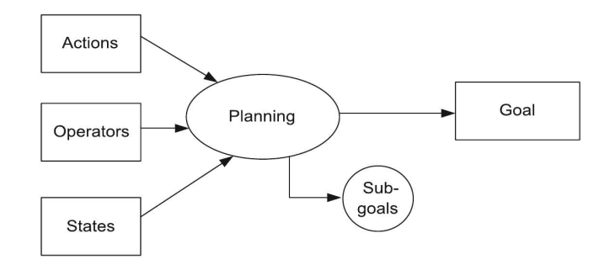
Basic Planning Representation
Planning representation involves
  1) State Representation
  2) Goal Representation
  3) Action Representation

Slide 7
Planning Representation
State Representation:
State representation defines how an agent perceives and models its environment, including current conditions and constraints.
State space: A state-space is a representation of the problem where each state represents a snapshot of the system's current condition, and actions transform one state into another.
Initial state: The starting point or the current condition of the agent before any actions are taken.
Variables and features: States are often described using variables and features, which capture relevant information about the environment and the agent's position.
Desired outcome: The goal state defines the desired condition that the agent aims to reach through its actions.
Example: In a robotic planning scenario, the state might be represented by the robot's location, the location of objects, and the status of various tasks.

Slide 8
Planning Representation
Goal Representation:
Goal representation specifies the desired outcome that the planning process aims to achieve. These two concepts are crucial for developing efficient and effective planning algorithms.
Goal conditions: Goals can be expressed as conditions that need to be satisfied in the final state, such as specific objects being at a particular location or tasks being completed.
Goal types: Goals can be deterministic (achieving a single specific state) or involve a range of acceptable states, depending on the problem.
Goal hierarchy: In some cases, goals may be organized hierarchically, with higher-level goals decomposed into sub-goals, allowing for more flexible and efficient planning.
Example: In a robotic planning, the goal might be to move a specific object to a particular location, or to complete a sequence of tasks in a certain order.

Slide 9
Planning Representation
Action Representation:
In AI, action representation refers to how an AI system understands and expresses what actions can be taken and their potential consequences.
It's crucial for AI to be able to plan, execute, and learn effectively within a given environment.
This representation helps AI models understand the impact of different actions and choose the most appropriate ones to achieve a desired goal.
Features:
Defining Actions: Action representation specifies what an AI system can do. This includes the types of actions available, their preconditions and their effects
Understanding Consequences: It helps AI understand the impact of actions.
Planning and Execution: It allows the AI to create a sequence of actions to achieve a goal by considering the consequences of each action.
Learning: AI can learn from its actions and their consequences, improving its ability to perform tasks and make decisions.

Slide 10
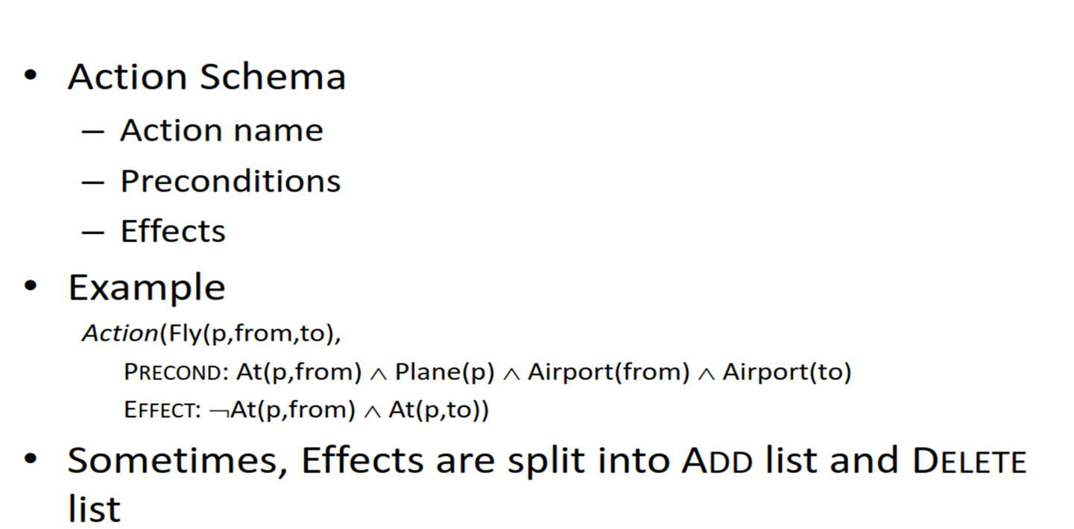
Action Representation

Slide 11
Planning vs Problem solving
Planning
Problem solving
Proactive: Planning involves envisioning the future and outlining the steps needed to achieve a desired outcome.
Future-oriented: It focuses on creating a roadmap for success, often involving long-term goals and strategies.
Systematic: Planning typically involves setting objectives, identifying resources, and assigning responsibilities.
Reactive: Problem-solving arises when something goes wrong or when there are obstacles to overcome.
Present-focused: It addresses immediate issues and finds solutions to restore progress towards the original goal.
Analytical: Problem-solving often involves identifying the root cause of the issue, exploring potential solutions, and evaluating their effectiveness.

Slide 12
Simple planning agent
A simple planning agent is very similar to problem-solving agents.
It constructs plans that achieve its goals, and then executes them.
The limitations of the problem- solving approach motivates the design of planning systems.
To solve a planning problem using a state-space search approach we would let the:
initial state = initial situation
goal-test predicate = goal state description
successor function computed from the set of operators
Once a goal is found, solution plan is the sequence of operators in the path from the start node to the goal node

Slide 13
Algorithm of a simple planning agent
1.Generate a goal to achieve
2. Construct a plan to achieve goal from current state
3. Execute plan until finished
4. Begin again with new goal
The agent first generates a goal to achieve, and then constructs a plan to achieve it from the current state.
Once it has a plan, it keeps executing it until the plan is finished, then begins again with a new goal.

Slide 14
Languages for Planning Problems
STRIPS
– Stanford Research Institute Problem Solver
– Historically important
ADL
– Action Description Languages
• PDDL
– Planning Domain Definition Language

Slide 15
Stanford Research Institute Problem Solver (STRIPS)
The STRIPS algorithm operates by maintaining a database of predicates that describe the state of the world.
Each action available to the system is defined in terms of its preconditions and its effects (both add and delete).
The planning process in STRIPS involves searching through the space of possible actions to find a sequence that transitions the system from the initial state to the state where the goal predicates are satisfied.
Planning with STRIPS:
Define the Initial State: Where the system starts.
Set the Goal State: What the system should achieve.
Develop Actions: Defined by their preconditions and effects.
Search for Solutions: Using a strategy like backward chaining from the goal state to the initial state, identifying actions that satisfy the goal conditions.

Slide 16
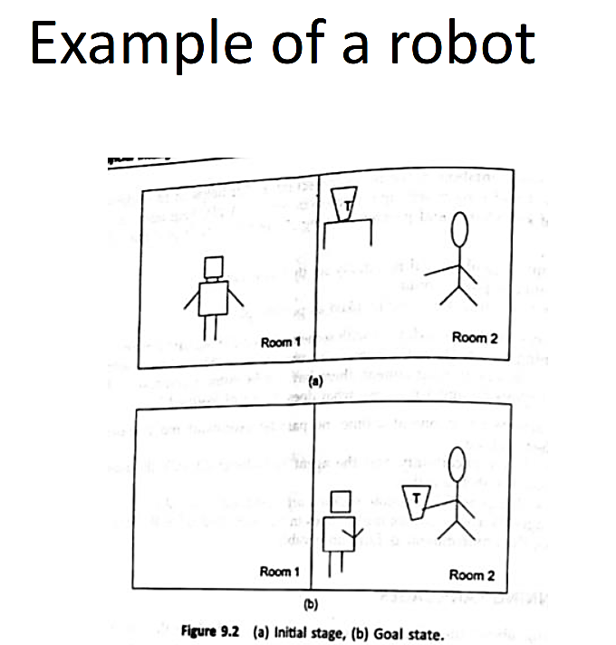
STRIPS
Example of a robot: The example involves a robot, a cup tea, guest and two rooms. We want the robot to get the tea and give it to the guest.

Slide 17
STRIPS
Move(robot, from, to)
Preconditions: At(robot, from)
Add Effects: At(robot, to)
Delete Effects: At(robot, from)
PickUp(robot, tea, room)
Preconditions: At(robot, room) ∧ At(tea, room)
Add Effects: Has(robot, tea)
Delete Effects: At(tea, room)
Give(robot, tea, guest, room)
Preconditions: At(robot, room) ∧ At(guest, room) ∧ Has(robot, tea)
Add Effects: Given(tea, guest)
Delete Effects: Has(robot, tea)
PickUp(robot, tea, room1)
Move(robot, room1, room2)
Give(robot, tea, guest, room2)

Slide 18
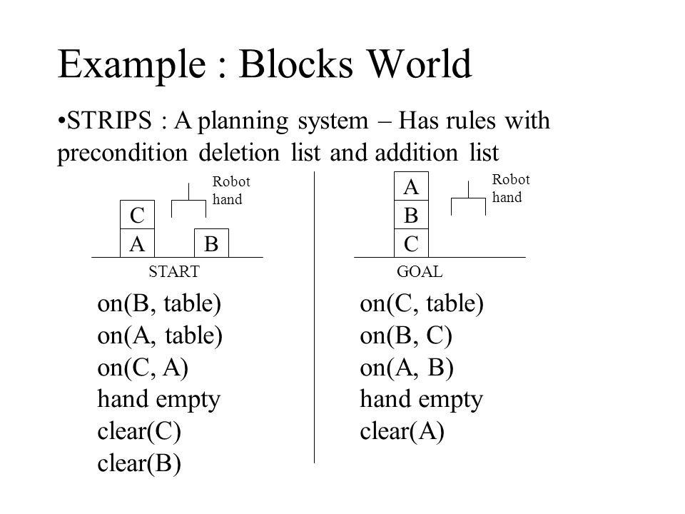
STRIPS has some limitations.
One is that it can only deal with a limited number of actions and goals.
Another is that it can only find plans that are guaranteed to work; it cannot find plans that are likely to work but might fail.

Slide 19
Action Description Language (ADL)
It is a formal language used to represent actions in AI planning systems.
ADL is used to describe the preconditions, effects, and dependencies of actions for automated planning.
It was developed as an advancement over the STRIPS planning system.
The properties of ADL are as follows:
1. It allows negative literals.
2. It makes use of quantified variables along with the disjunctions and the conjunctions.
3. Conditional post-conditions are allowed.
4. Variables with different types at the same time are allowed and also equality property is available.

Slide 20
Planning Domain Description Language (PDDL)
The Planning Domain Definition Language (PDDL) is a standardized version of ADL.
It is a superset of STRIPS and ADL that allows features like
1. Objects can have type specifications.
2. It can have negative pre-conditions.
3. The add and delete lists can be conditional.
4. In some cases, it also allows numeric values.

Slide 21
Means - Ends Analysis
Means-Ends Analysis is problem-solving techniques used in Artificial intelligence for limiting search in AI programs.
• It is a mixture of Backward and forward search technique.
• The means -ends analysis process centers around finding the difference between current state and goal state.
Search strategies are either reason forward of backward.
Steps
1. First, evaluate the difference between Initial State and final State.
2. Select the various operators which can be applied for each difference.
3. Apply the operator at each difference, which reduces the difference between the current state and goal state.

Slide 22
MEA Algorithm
Step 1: Compare CURRENT to GOAL, if there are no differences between both then return Success and Exit.
• Step 2: Else, select the most significant difference and reduce it by doing the following steps until the success or failure occurs.
A) Select a new operator O which is applicable for the current difference, and if there is no such operator, then signal failure.
B) Attempt to apply operator O to CURRENT. Make a description of two states.
i) O-Start, a state in which O?s preconditions are satisfied.
  ii) O-Result, the state that would result if O were applied In O-start.
C) If
(First-Part <------ MEA (CURRENT, O-START)
And
(LAST-Part <----- MEA (O-Result, GOAL), are successful, then signal
Success and return the result of combining FIRST-PART, O, and LASTPART.

Slide 23
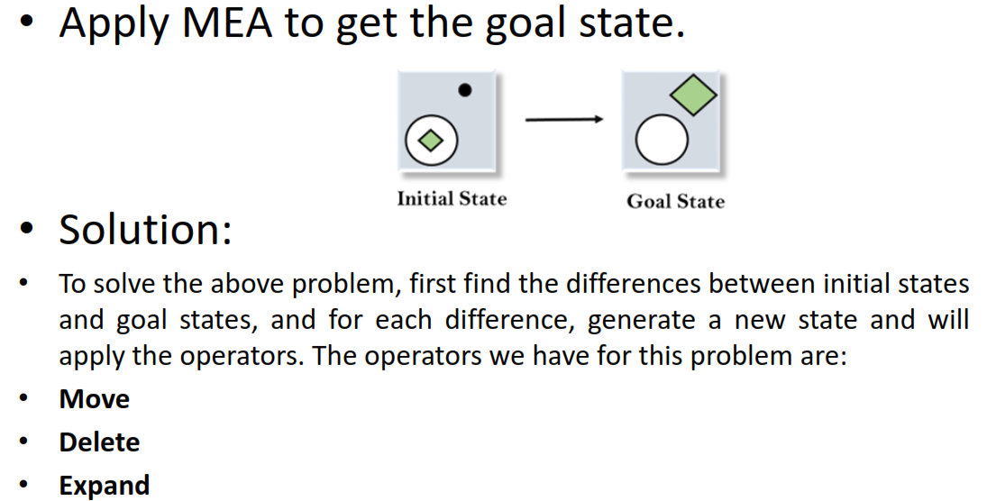
Example of Mean-Ends Analysis:

Slide 24
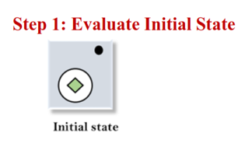
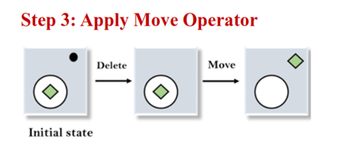
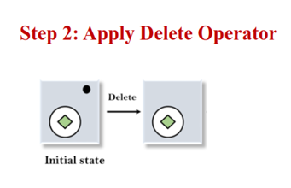
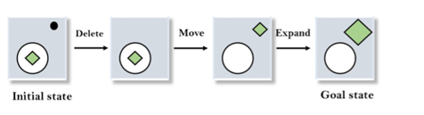
Example of Mean-Ends Analysis:

Slide 25
Linear Planning - Block World
There are ‘N’ number of Blocks resting on table with specified sequence.
• Goal is to arrange in desired sequence.
• Available moves
– Put block on table
– Put a block on another block top
• State is represented using sequence of blocks in current pos.

Slide 26
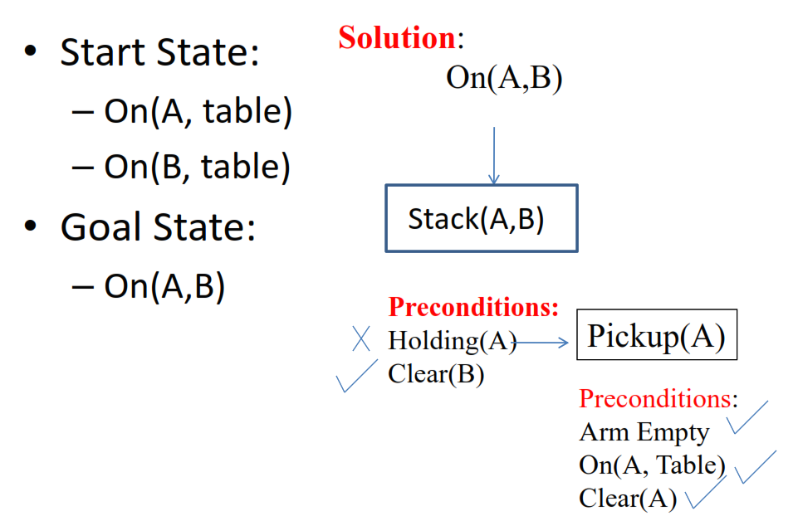
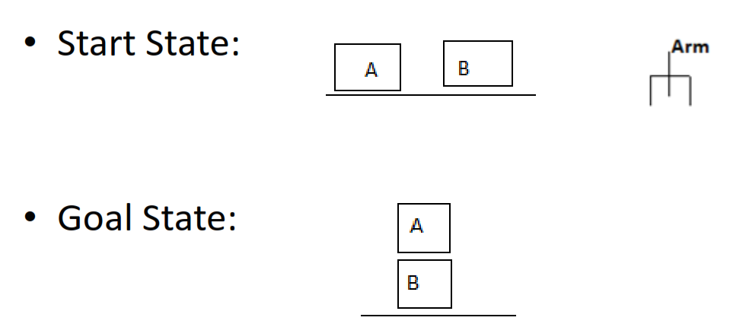
Linear Planning - Block World

Slide 27
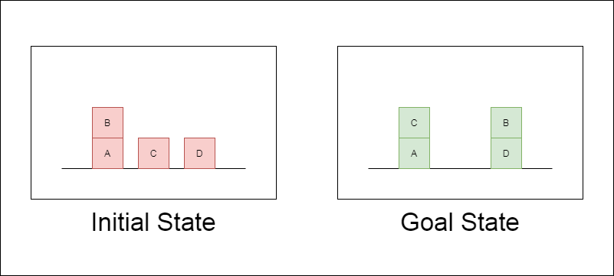
Linear Planning - Block World
The Robot Arm can perform 4 operations:
STACK(X,Y) : Stacking Block X on Block Y
UNSTACK(X,Y) : Picking up Block X which is on top of Block Y
PICKUP(X) : Picking up Block X which is on top of the table
PUTDOWN(X) : Put Block X on the table

Slide 28
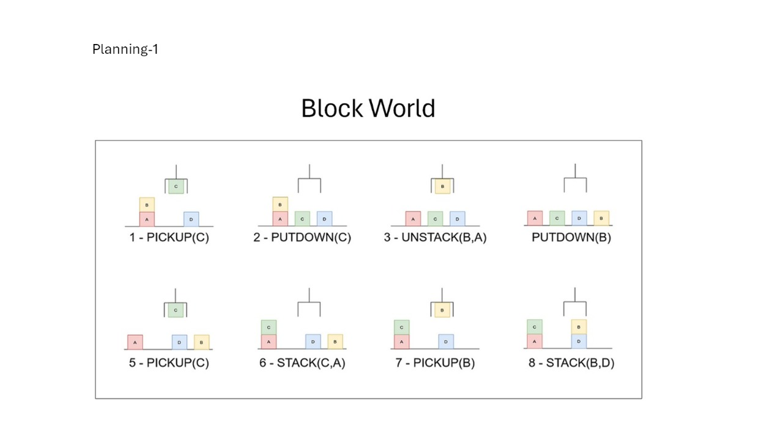
Linear Planning - Block World

Slide 29
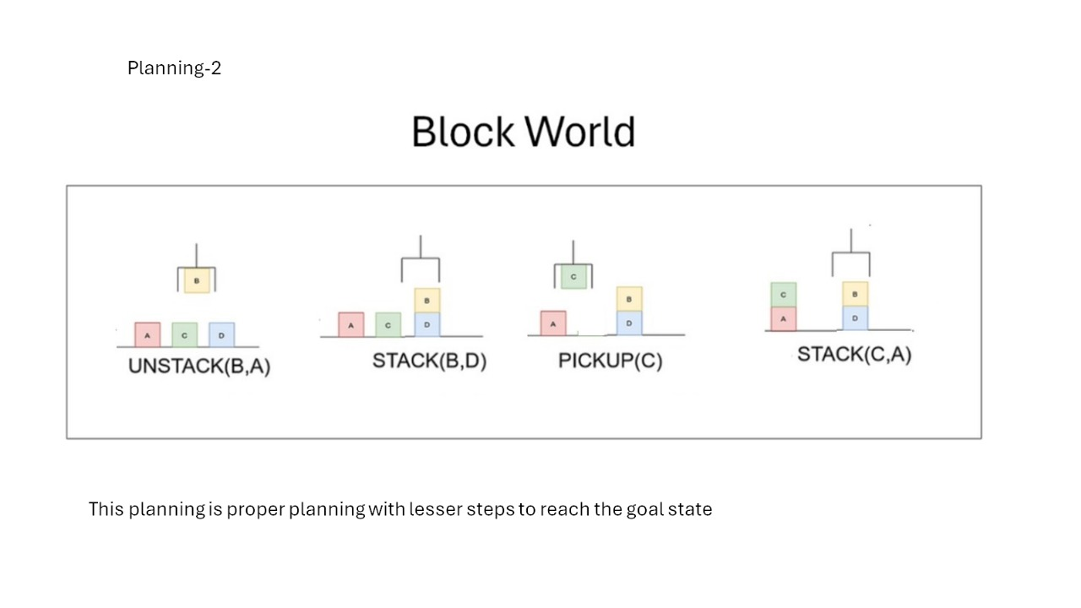
Linear Planning - Block World

Slide 30
Non-linear planning
A plan that consists of sub-problems, which are solved simultaneously is said non-linear plan.
There is a concept of constraint posting that comes with non-linear planning. The constraint posting states that the plan can be built by
1. Addition of operators or suggesting operators
2. Ordering them
3. Binding the variables to the operators

Slide 31
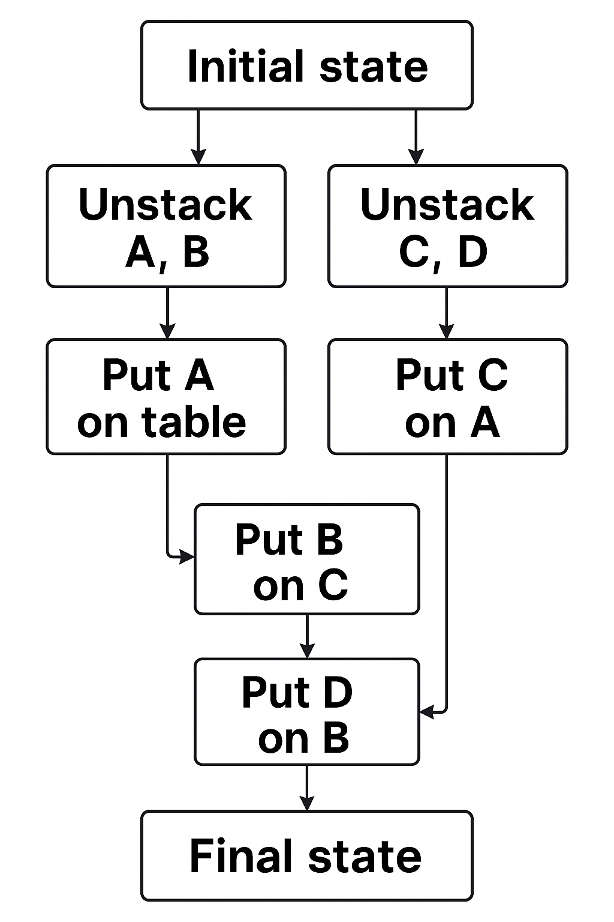
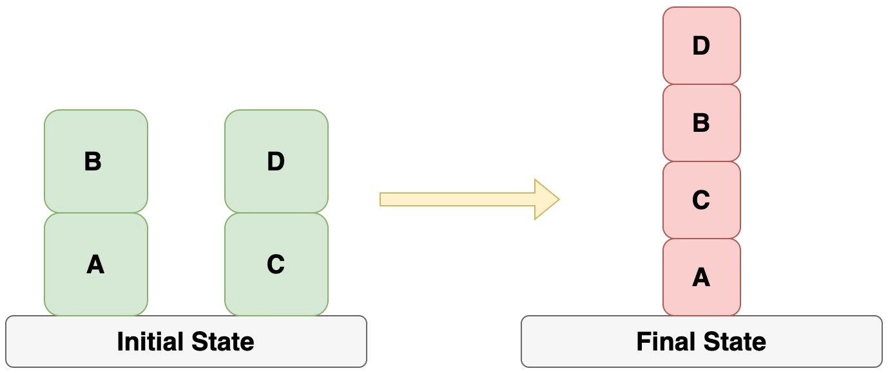
Non-linear planning

Slide 32
Conditional Planning
Conditional planning has to work regardless of the outcome of an action.
• The outcome of actions cannot be determined so the environment is said to be nondeterministic.
• It’s a way to deal with uncertainty by checking what is actually happening in the environment at predetermined points in the plan. (Conditional Steps)
Example:
A robot needs to deliver a package, but it doesn't know if the door to the delivery room is open or closed.
Plan:
Move to the door
Sense whether the door is open or closed
If door is open → Enter the room and deliver the package
If door is closed → Press the doorbell and wait
  When door opens → Enter and deliver the package
  If still closed →→ Leave a delivery note→ Return to base or retry later

Slide 33
Reactive Planning
Reactive planning is planning under uncertainty.
• Makes use of the if-then rules.
• The reactive planners are based on the concept that they should be able to handle an unknown situation too. So, the reaction rules are used that help them in doing so.
• A rule selection is based on the priority and a holding condition that maximises the priority.
Example:
A robot vacuum cleaner is cleaning a room. It doesn’t have a detailed map. It just reacts based on its sensors.
Plan (reactive):
If it detects dirt → Move toward dirt and clean
If it senses an obstacle (like a wall) → Turn and move in another direction
If the battery is low → Immediately stop cleaning and return to charging station

Slide 34
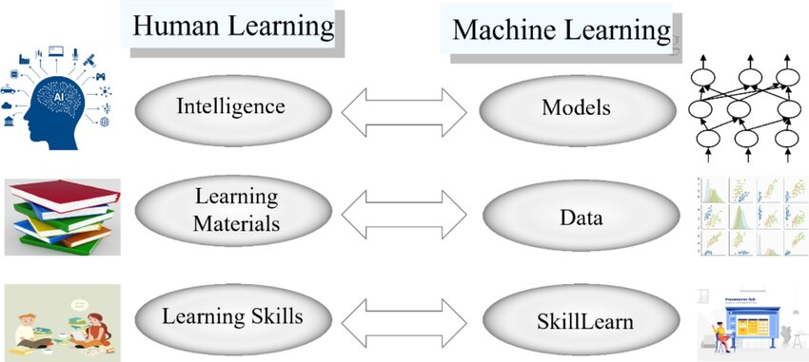
Machine Learning
Machine learning is a field of artificial intelligence that focuses on enabling computers to learn from data without being explicitly programmed.
It involves creating algorithms that can analyze patterns in data and generate models for specific tasks, allowing for accurate predictions and intelligent behavior.

Slide 35
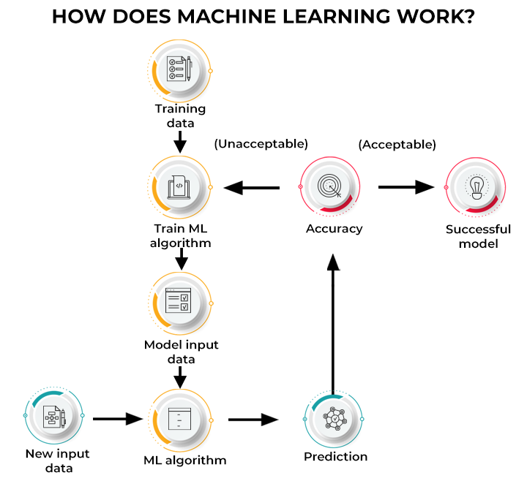

Slide 36
Machine Learning
Goals of machine learning
To produce learning algorithms with practical value.
• Development and enhancement of computer algorithms and models to meet the decision making requirements in practical scenarios.
• To facilitate in building Intelligent System (IS) that can be used in solving real time problems.
Challenges of Machine Learning
Availability of limited learning data and unknown perspectives.
• Acquiring Accurate , compact and precise knowledge building.
• Require large working memory to store data.
• Focusing Too Much on Algorithms and Theories
• Monitoring and maintenance

Slide 37
Machine Learning
Types of Machine Learning
Rote learning
• Learning from observations
  Learning from agents
  Inductive learning
  Decision tree learning
• Supervised learning
• Unsupervised learning
• Semi-supervised learning
• Ensemble learning
• Discovery based learning
• Learning by problem solving
Computational structure used in Machine learning:
1. Functions.
2. Logic programs and rule sets
3. Finite state machines
4. Grammars
5. Problem solving system

Slide 38
ML - Rote Learning
Rote learning is a rudimentary form of learning, which focusses on memorization.
Here, the values are stored so that these are not re-computed.
When computations are more expensive than re-computing from scratch, this strategy can save a significant amount of time.
Selective paging and caching are some of the examples of rote learning.

Slide 39
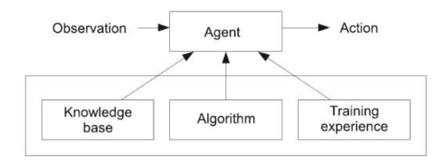
ML - Learning from agents
•An agent is defined the computational entity which is capable of receiving the environment and can act based on the situation.
•The agent is composed of learning element performance element and a curiosity element.
•Based on the coordination between these elements the outcome of the agent’s behavior is measured.

Slide 40
ML - Inductive Learning
Inductive learning involves learning generalized rules from specific examples (can think of this as the “inverse” of deduction)
Main task: given a set of examples, each classified as positive or negative produce a concept description that matches exactly the positive examples.
The examples are coded in some representation language, e.g. they are coded by a finite set of real-valued features.
The concept description is in a certain language that is presumably a superset of the language of possible example encodings.
A “correct” concept description is one that classifies correctly ALL possible examples, not just those given in the training set.

Slide 41
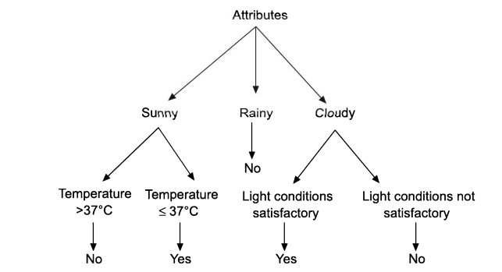
ML - Decision Tree Learning
The learned function is represented by a decision tree.
In terms of programming it is also represented as if then rules.
Decision tree depicts the simple learning from the observation, method.
Based on the observation, at every node, decision is taken.

Slide 42
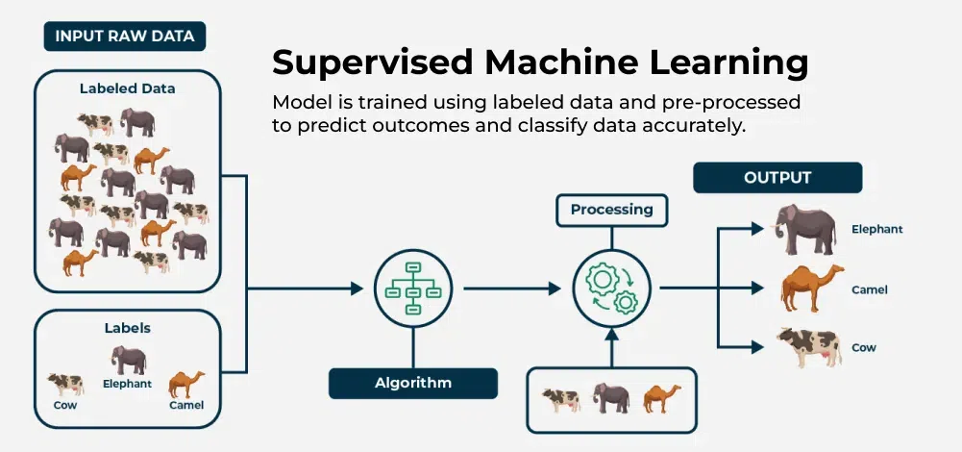
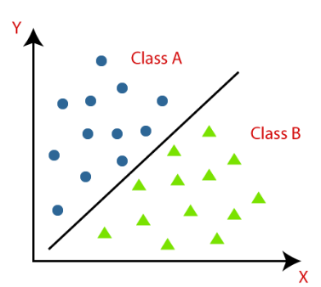
ML - Supervised learning
Uses labelled dataset.
Supervised learning is the learning algorithm that is provided with the set of training data and the algorithm further induces the classifier to classify the unseen or new data.
A hyperplane in Machine Learning is a crucial deciding boundary that partitions the input space into two or more sections, with each section corresponding to a unique class or output label.

Slide 43
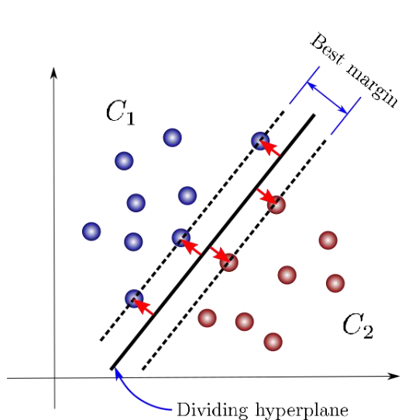
Hyperplane
Hyperplane is a line that linearly separates and classifies a set of data.
The further from the hyperplane our data points lie, the more confident we are that they have been correctly classified.
We therefore want our data points to be as far away from the hyperplane as possible, while still being on the correct side of it.
So when new testing data are added, whatever side of the hyperplane it lands will decide the class that we assign to it.

Slide 44
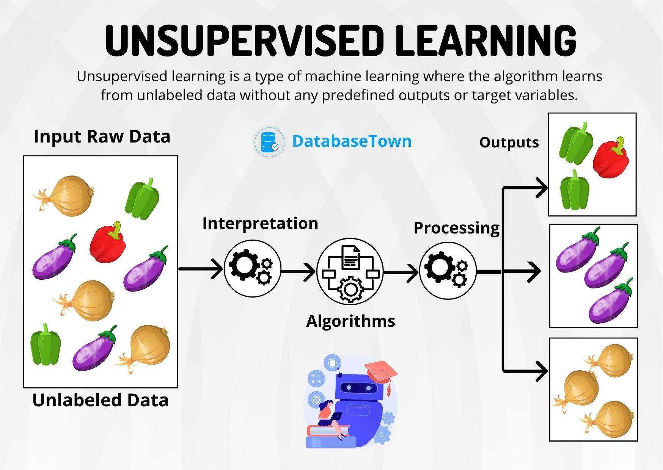
ML - Unsupervised Learning
Use unlabeled dataset.
Learning is more based on similarities and differences which are visible.
Grouping and categorization of the objects is based on the understanding of similarities and visualization of their relations
Unsupervised learning performs hierarchical clustering.

Slide 45
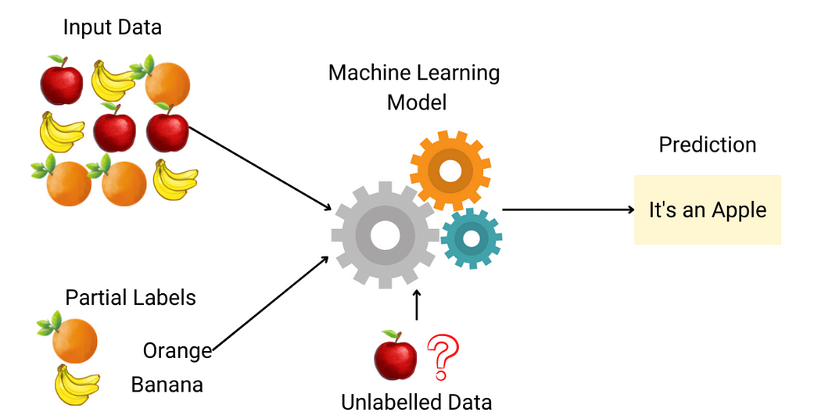
ML - Semi supervised Learning
Semi-supervised learning is a machine learning technique that uses a combination of supervised and unsupervised learning by applying labeled and unlabeled data to train a model.
Labeled data provides the model with explicit examples of what input data corresponds to which labels, allowing the model to learn to predict it for new data.
Unlabeled data is then used to refine and improve this model, helping it better understand its overall structure and distribution

Slide 46
ML - Ensemble Learning
• An ensemble model combines several individual models to produce more accurate predictions than a single model alone.
• The most commonly used ensemble learning methods are
1.Boosting:
• Boosting can probably be defined as the method for generating accurate predictions by combining the rules that are comparatively inaccurate.
• Boosting works on the weighted training sets. The weights of the training example reflects the importance of training examples.
2.Bagging:
• In Bagging, the training data is resampled. This is referred to as bootstrap sampling, where the training data with replacement is taken in the learning approaches.

Slide 47
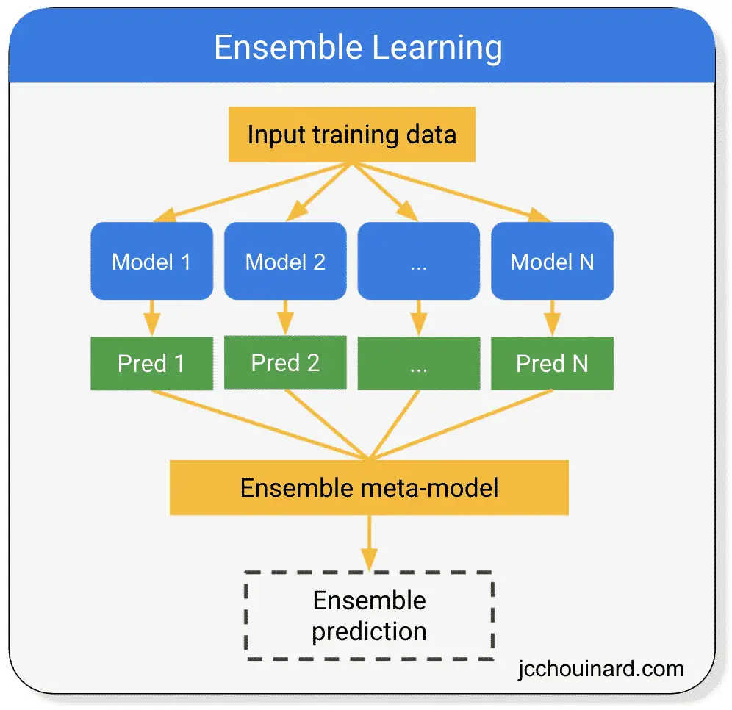
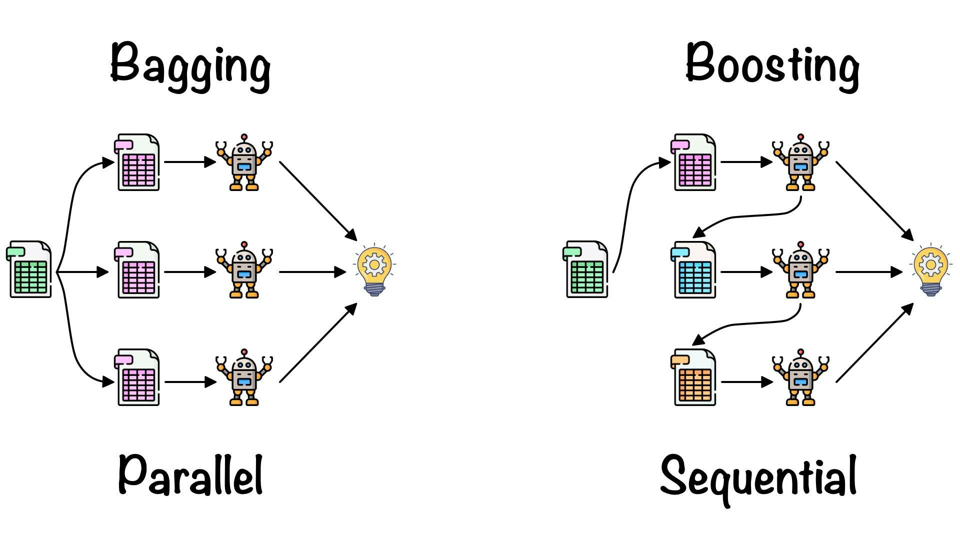
ML - Ensemble Learning

Slide 48
ML
Discovery-based Learning
In case of discovery learning the learning, takes place without any help of teacher or supervisor.
It is called unsupervised.
It can be said to be inquiry-based learning, where the learner on the basis of past experience and knowledge tries to discover the outcomes.
Learning by Problem Solving
In learning from problem solving, various parameters related to solution and problem are considered.
These parameters are used and effectively desirability of a particular outcome or decision is determined.
It is typically based on the way a problem is solved and the outcomes at every step.
Even in pattern-based decision- making, the correct category is determined based on the previous results.

Slide 49
ML - Learning Methods
Artificial neural network-based learning - Back propagation
Support vector machines
Reinforcement learning
Adaptive learning
Multi agent based learning
Distributed learning
Speedup learning

Slide 50
Artificial neural network based learning
An Artificial Neural Network (ANN) is a computational model inspired by the human brain’s neural structure.
It consists of interconnected nodes (neurons) organized into layers.
Information flows through these nodes, and the network adjusts the connection strengths (weights) during training to learn from data, enabling it to recognize patterns, make predictions, and solve various tasks in machine learning and artificial intelligence.

Slide 51
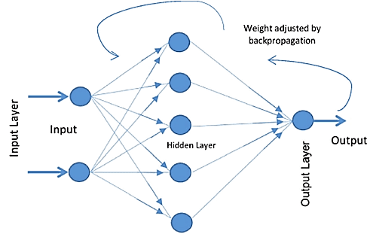
ANN - Back propagation Algorithm
Back-propagation is the essence of neural net training.
It is the method of fine-tuning the weights of a neural net based on the error rate obtained in the previous epoch (i.e., iteration).
Proper tuning of the weights allows you to reduce error rates and to make the model reliable by increasing its generalization.

Slide 52
ANN - Back propagation Algorithm
1.Inputs X, arrive through the preconnected path
2. Input is modeled using real weights W. The weights are usually randomly selected.
3. Calculate the output for every neuron from the input layer, to the hidden layers, to the output layer.
4. Calculate the error in the outputs.
ErrorB= Actual Output – Desired Output
5. Travel back from the output layer to the hidden layer to adjust the weights such that the error is decreased.
6. Keep repeating the process until the desired output is achieved.

Slide 53
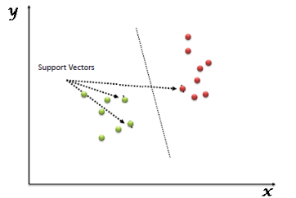
Support Vector Machine (SVM)
Support vector machines (SVM) are supervised learning models with associated learning algorithms that analyze data used for classification and regression analysis.
• It is a machine learning approach.
• They analyze the large amount of data to identify patterns from them.
• SVMs are based on the idea of finding a hyperplane that best divides a dataset into two classes, as shown in the image below.

Slide 54
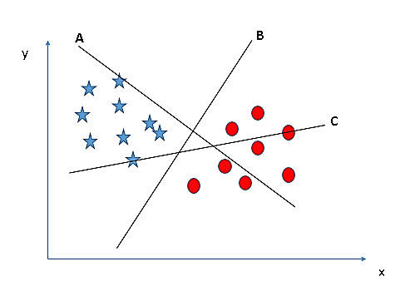
Identify the right hyperplane (Scenario-1):
Here, we have three hyperplanes (A, B and C). Now, identify the right hyperplane to classify star and circle.
Hyperplane “B” has excellently performed this job.

Slide 55
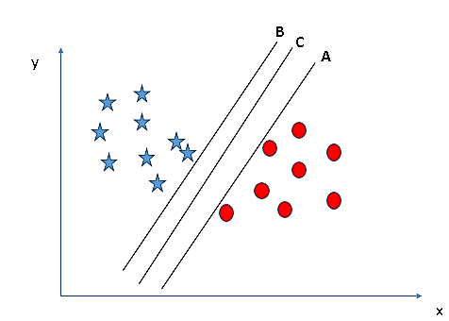
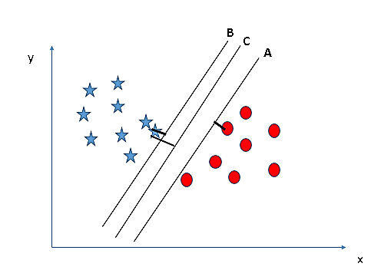
Identify the right hyperplane (Scenario-2):
Here, we have three hyperplanes (A, B and C) and all are segregating the classes well. Now, how can we identify the right hyperplane?
Here, maximizing the distances between nearest
data point (either class) and hyperplane will help us to decide the right hyperplane.
This distance is called as Margin. Let’s look at the second fig
We can see that the margin for hyperplane C is high as compared to both A and B. Hence, we name the right hyperplane as C.
Another reason for selecting the hyperplane with higher margin is robustness. If we select a hyperplane having low margin then there is high chance of misclassification.

Slide 56
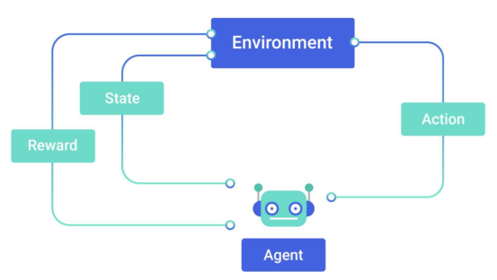
Reinforcement Learning
Learning from interaction with an environment to achieve some long-term goal that is related to the state of the environment
• The goal is defined by reward signal, which must be maximised.
• Agent must be able to partially/fully sense the environment state and take actions to influence the environment state
• The state is typically described with a feature vector

Slide 57
Reinforcement Learning Systems
Reinforcement learning systems have 4 main elements:
1.Policy-A policy is a mapping from the perceived states of the environment to actions to be taken when in those states
• A reinforcement learning agent uses a policy to select actions given the current environment state
An on-policy agent learns only about the policy that it is executing
• An off-policy agent learns about a policy or policies different from the one that it is executing.
2. Reward signal
The reward signal defines the goal
• On each time step, the environment sends a single number called the reward to the reinforcement learning agent,
• The agent’s objective is to maximize the total reward that it receives over the long run
• The reward signal is used to alter the policy

Slide 58
Reinforcement Learning Systems
3.Value function
• The value of a state is the total amount of reward an agent can expect to accumulate over the future, starting in that state.
• Values must continually be re-estimated from the sequence of observations that an agent makes over its lifetime.
4. Optional model of the environment
A model of the environment allows inferences to be made about how the environment will behave.
• Example: Given a state and an action to be taken while in that state, the model could predict the next state and the next reward.
• Models are used for planning, which means deciding on a course of action by considering possible future situations before they are experienced

Slide 59
Adaptive learning
• Adaptive machine learning algorithms are the machine learning models, where the changes in the environment help in selecting the algorithm or learning method.
• The adaptive learning solves some of the complex problems for which a single learning method is not enough.
• This method is even more appropriate when the environment is continuously changing and real time response is expected.

Slide 60
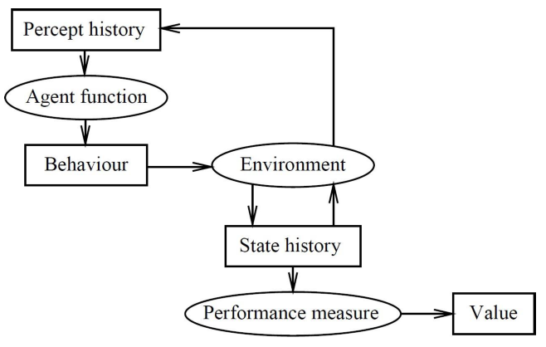
Multi-Agent System
A system with multiple autonomous entities, with distributed information, computational ability, and possibly divergent interests.
A multiagent system is one that consists of a number of agents, which interact with one-another
In the most general case, agents will be acting on behalf of users with different goals and motivations
To successfully interact, they will require the ability to cooperate, coordinate, and negotiate with each other, much as people do

Slide 61
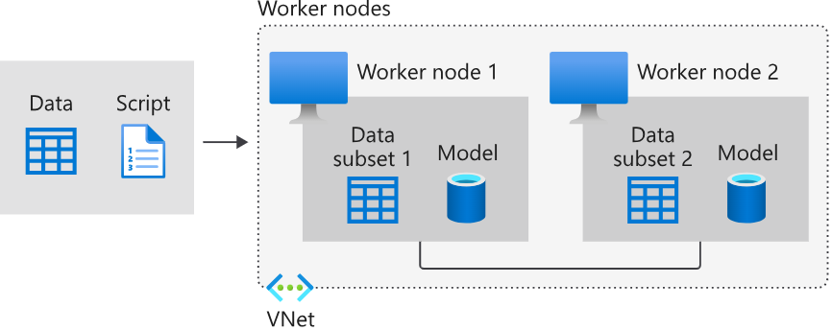
Distributed learning
In distributed learning the task of learning is distributed.
Need for distributed learning - Arises due to large data sets and time constraints.
More than one agent in different parts of the data set.
There will be distributed learning algorithms taken part in each partition to get the desired outcome, which would then be combined.
Multi agent systems can be thought of as a subset of distributed learning.

Slide 62
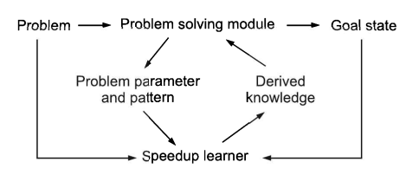
Speedup learning
Speedup learning studies learning mechanisms for speeding up problem solvers based on problem-solving experience.
The input to a speedup learner typically consists of observations of prior problem-solving experience, which may include traces of the problem solver’s operations and/or solutions to solve the problems.
The output is knowledge that the problem solver can exploit to find solutions more quickly than before learning without seriously effecting the solution quality.
In this learning,
There is no interaction with the
environment.
2. New problems cannot be solved.

Slide 63
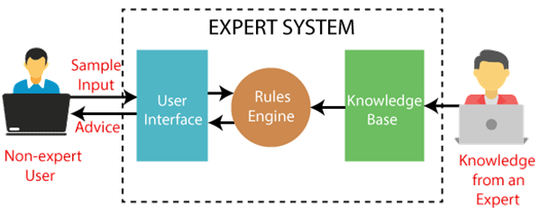
Expert System
An expert system is a computer program that is designed to solve complex problems and to provide decision-making ability like a human expert.
It performs this by extracting knowledge from its knowledge base using the reasoning and inference rules according to the user queries.

Slide 64
Characteristics of Expert System
High Performance: The expert system provides high performance for solving any type of complex problem of a specific domain with high efficiency and accuracy.
Understandable: It responds in a way that can be easily understandable by the user. It can take input in human language and provides the output in the same way.
Reliable: It is much reliable for generating an efficient and accurate output.
Highly responsive: ES provides the result for any complex query within a very short period of time.

Slide 65
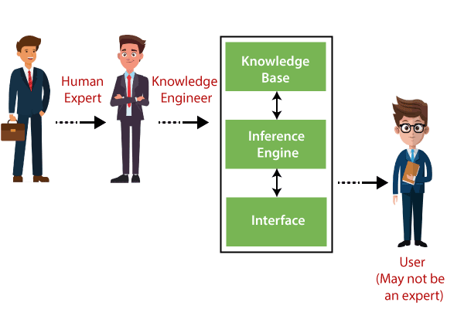
Components of Expert System

Slide 66
Components of Expert System
1. User Interface
With the help of a user interface, the expert system interacts with the user, takes queries as an input in a readable format, and passes it to the inference engine.
After getting the response from the inference engine, it displays the output to the user.
In other words, it is an interface that helps a non-expert user to communicate with the expert system to find a solution.
2. Inference Engine(Rules of Engine)
The inference engine is known as the brain of the expert system as it is the main processing unit of the system.
It applies inference rules to the knowledge base to derive a conclusion or deduce new information.
It helps in deriving an error-free solution of queries asked by the user.
3. Knowledge Base
The knowledgebase is a type of storage that stores knowledge acquired from the different experts of the particular domain.
It is considered as big storage of knowledge.
The more the knowledge base, the more precise will be the Expert System.

Slide 67
Expert Systems
DENDRAL: It was an artificial intelligence project that was made as a chemical analysis expert system. It was used in organic chemistry to detect unknown organic molecules with the help of their mass spectra and knowledge base of chemistry.
MYCIN: It was one of the earliest backward chaining expert systems that was designed to find the bacteria causing infections like bacteraemia and meningitis. It was also used for the recommendation of antibiotics and the diagnosis of blood clotting diseases.
PXDES: It is an expert system that is used to determine the type and level of lung cancer. To determine the disease, it takes a picture from the upper body, which looks like the shadow. This shadow identifies the type and degree of harm.
CaDeT: The CaDet expert system is a diagnostic support system that can detect cancer at early stages.

Slide 68
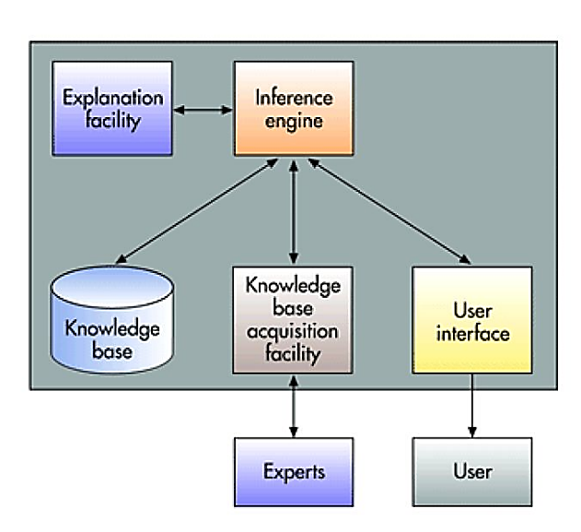
Architecture of Expert System

Slide 69
Architecture of Expert System
Explanation Facility
Allows a user to understand how the expert system arrived at certain conclusions or results.
For example: it allows a doctor to find out the logic or rationale of the diagnosis made by a medical expert system.
Inference Engine
Seeks information and relationships from the knowledge base and provides answers, predictions, and suggestions the way a human expert would.
Knowledge Base
Stores all relevant information, data, rules, cases, and relationships used by the expert system.
It uses rules, If-then statements, fuzzy logic
Knowledge acquisition facility
Provide convenient and efficient means of capturing and storing all the components of the knowledge base.
Acts as an interface between experts and the knowledge base.
User Interface
Specialized user interface software employed for designing, creating, updating, and using expert systems.
The main purpose of the user interface is to make the development and use of an expert system easier for users and decision makers

Slide 70
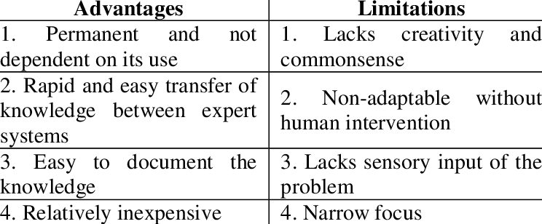
Advantages and Limitations of Expert Systems

